Slide 1
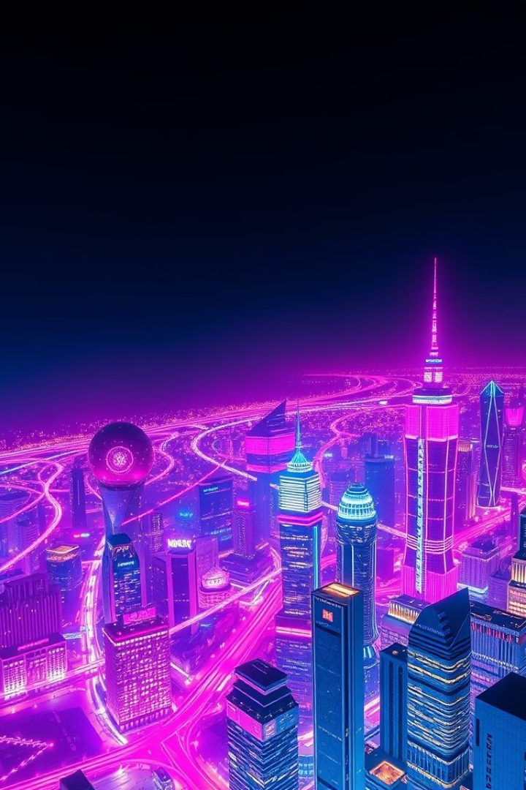
Smart City Dashboard
Welcome to the Future
of Urban Living
Experience the power of smart city technology at your fingertips
A unified platform for real-time urban monitoring and data-driven decisions.

Slide 2
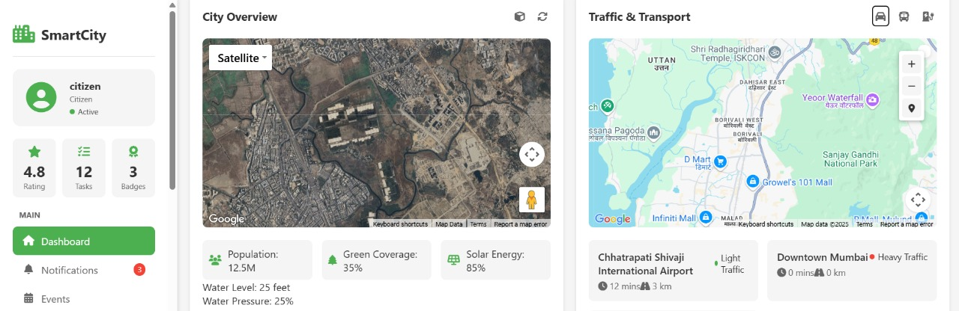
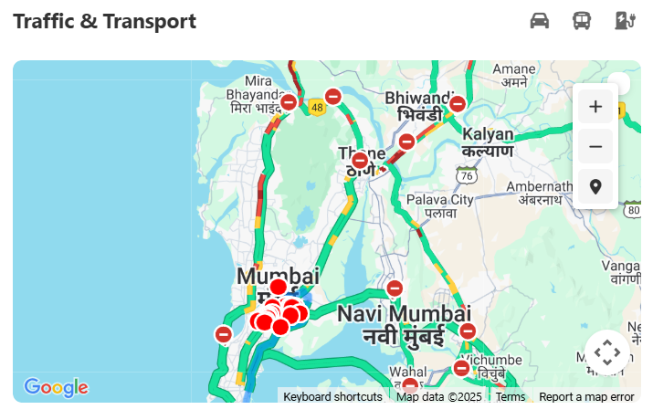
Smart City Dashboard
Centralized dashboard for real-time data visualization. Integrates IoT sensors, open data APIs, and user inputs.
Traffic
Air Quality
Energy Usage
Real-time traffic flow monitoring.
Monitor pollution levels.
Track energy consumption.

Slide 3

Key Requirements
1
Real-time Data
2
Smart Alerts
Visualize data from IoT sensors and open Data APIs
AI-driven notifications and alerts.
3
Seamless Integration
Connect with mapping and emergency systems.

Slide 4
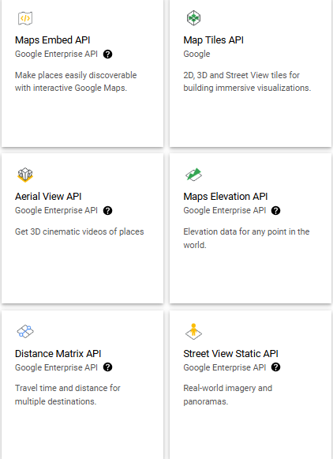



Tech Stack Overview
Frontend
HTML, CSS, JavaScript.
Backend
Django, SQLite.
APIs
Google Maps, OpenWeather, Python News.

Slide 5
API Integrations
Google Maps API
OpenWeather API
Python News API
Displays traffic and emergency routes.
Fetches weather and environmental data.
Provides updates on local events and alerts.

Slide 6
DEMO

Slide 7
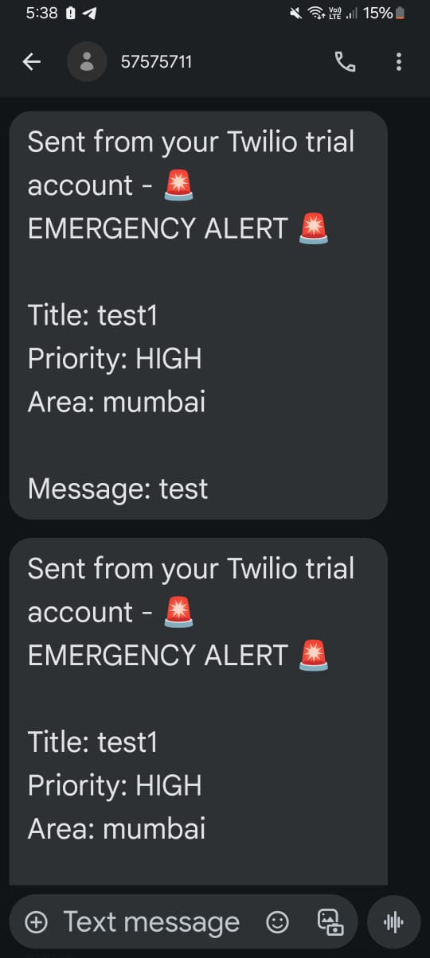


Alert System By Twilio
Real-time Notifications
SMS alerts.
Email Alerts
Email notifications.

Slide 8
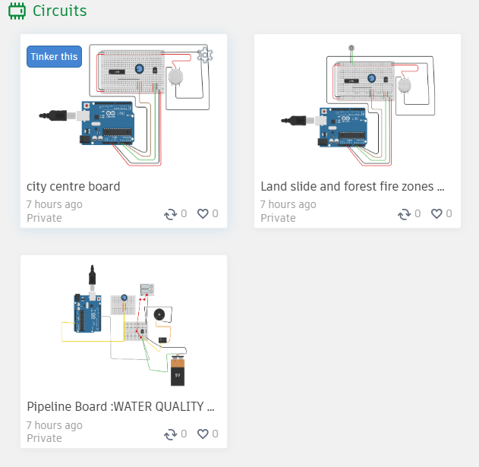

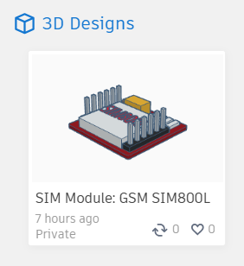


IoT Implementation
City Centre Board
Air quality, wind pressure, smoke detection.
Water Pipeline Board
Water quality, leakage detection.
Landslide & Forest Fire Board
Vibration, temperature, wind speed, smoke detection.

Slide 9
IoT Implementation & Costing
City Centre |  | Pipeline |  | Landslide/Forest Fire
Type | Name | Type | Name | Type | Name
Temperature | DH 11 | Pressure Valve | Elect. Solenoid | Temperature | DH 11
Wind | Aneometer | Quality | pH + TDS | Wind | Aneometer
Smoke | MQ-2 |  |  | Smoke | MQ-2
 |  |  |  | Vibration | Pezeoelectric
Board Type | Cost Per Unit | Cost Of covering Vasai (Virar - Bhaynder) | Cost Of covering Mumbai (Onwars-)
City Centre | 800-1000 | 1.8 Lakhs | 3.5 Lakhs
Pipeline | 1200-2500
Landslide/Forest Fire | 1000-2300

Slide 10



Business Model
Subscription
1
Premium features for enterprises.
B2G
2
Solutions for municipal corporations.
B2B
3
Partnerships with real estate developers.

Slide 11

Market Potential
1
2
Growing Demand
Government Funding
Smart city solutions globally.
Urban digital transformation.
3
Potential Partnerships
Environmental agencies and emergency services.

Slide 12
Thank You
QnA?

